Slide 1



3130704
Digital Fundamentals
Module 5:
Semiconductor memories and Programmable logic devices
Prof. Krunal D. Vyas
9601901005
krunal.vyas@darshan.ac.in

Slide 2
Topics to be covered
Memory organization and operation
Expanding memory size
Classification and characteristics of memories
Programmable logic array (PLA)
Programmable array logic (PAL)
Complex programmable logic devices (CPLD)
Field programmable gate array (FPGA)

Slide 3
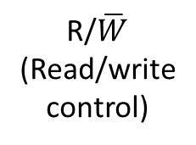
Memory organization and operation
Bidirectional data bus
Mainly two types of operations
Write operation
Read operation
Address bus
R/$\overline{W}$
(Read/write control)
Memory
CS
(chip select)

Slide 4






Memory expansion
Example:- Show how to combine several 16 x 4 RAM to form a 16 x 8 RAM.
A₃
A₂
A₁
A₀
R/$\overline{W}$
A₃
A₂
A₁
A₀
A₃
A₂
A₁
A₀
R/$\overline{W}$
R/$\overline{W}$
RAM 1
16 x 4
RAM 2
16 x 4
$$\overline{CS}$$
$$\overline{CS}$$
$$\overline{CS}$$
D₃
D₂
D₁
D₀
D₃
D₂
D₁
D₀
D₇
D₃
D₆
D₂
D₅
D₁
D₄
D₀

Slide 5
Memory expansion
Example:- Show how to combine several 1K x 8 PROMs to produce 4K x 8 PROM.
Solution:- 1K x 8 PROM has 10 number of address lines because 2¹⁰ = 1024 (1K).
We need total 4 number of 1K x 8 PROM chips to make one 4K x 8 PROM chip.

Slide 6




Memory expansion
D₇
D₀
PROM 1
1K x 8
PROM 1
1K x 8
PROM 1
1K x 8
PROM 1
1K x 8
$$\overline{CS}$$
$$\overline{CS}$$
$$\overline{CS}$$
$$\overline{CS}$$
A₉
A₀
A₁₁
O₀
2 to 4 decoder
O₁
A₁₀
O₂
O₃

Slide 7
Memory expansion
A₁₁
A₁₀
A₉
A₈
A₇
A₆
A₅
A₄
A₃
A₂
A₁
A₀
0
0
0
0
0
0
0
0
0
0
0
0
0
0
1
1
1
1
1
1
1
1
1
1
Memory chip | Starting address | Ending address
PROM 1 | 000 H | 3FF H
PROM 2 | 400 H | 7FF H
PROM 3 | 800 H | BFF H
PROM 4 | C00 H | FFF H

Slide 8
Classification of memories
Read only memory (ROM)
Read and write memory (RWM or RAM)
Content addressable memory (CAM)
Charge coupled device memory (CCD)

Slide 9
Read-Only Memory (ROM)
A read-only memory (ROM) is essentially a memory device in which permanent binary information is stored.
The binary information must be specified by the designer and is then embedded in the unit to form the required interconnection pattern.
Once the pattern is established, it stays within the unit when the power is turned off and on again.
A ROM which can be programmed is called a PROM. The process of entering information in a ROM is known as programming.
ROMs are used to store information which is of fixed type, such as tables for various functions, fixed data and instructions.
ROMs can be used for designing combinational logic circuits.

Slide 10
Read-Only Memory
Advantages of using a ROM as a PLD
Ease of design since no simplification or minimization of logic function is required
Designs can be changed, modified easily
Faster than discrete MSI/SSI circuit
Cost is reduced
Disadvantages of ROM based circuits
Non-utilization of complete circuit
Increased power requirement
Enormous increase in size with increase in number of input variables

Slide 11
ROM Organization
2^{k} x n
ROM
k inputs (address)
n outputs (data)
k inputs – provide address for the memory
n outputs – data bits of the stored word selected by address
k address input lines specify 2^{k} words
ROM does not have data inputs because it does not have write operation.

Slide 12
ROM Organization
Internal logic of 32 x 8 ROM
0
1
I₀
2
3
I₁
5 x 32 decoder
•
I₂
•
•
I₃
28
I₄
29
30
31
A₇
A₆
A₅
A₄
A₃
A₂
A₁
A₀

Slide 13
32 x 8 ROM
Consider, for example, a 32 x 8 ROM.
The unit consists of 32 words of 8 bits each.
There are five input lines that form the binary numbers from 0 through 31 for the address.
The five inputs are decoded into 32 distinct outputs by means of a 5 x 32 decoder.
Each output of the decoder represents a memory address.

Slide 14
32 x 8 ROM
The 32 outputs of the decoder are connected to each of the 8 OR gates.
Each OR gate must be considered as having 32 inputs.
Since each OR gate has 32 input connections and there are 8 OR gates, the ROM contains 32 x 8 = 256 internal connections.
In general, a 2^{k} x n ROM will have an internal k x 2^{k} decoder and n OR gates.
Each OR gate has 2^{k} inputs, which are connected to each of the outputs of the decoder.

Slide 15
Example
Implement following functions using ROM.
F₁ = ∑ m(1, 3, 4, 6) F₂ = ∑ m(2, 4, 5, 7)
F₃ = ∑ m(0, 1, 5, 7) F₄ = ∑ m(1, 2, 3, 4)
A₂ | A₁ | A₀ | F₁ | F₂ | F₃ | F₄
0 | 0 | 0 | 0 | 0 | 1 | 0
0 | 0 | 1 | 1 | 0 | 1 | 1
0 | 1 | 0 | 0 | 1 | 0 | 1
0 | 1 | 1 | 1 | 0 | 0 | 1
1 | 0 | 0 | 1 | 1 | 0 | 1
1 | 0 | 1 | 0 | 1 | 1 | 0
1 | 1 | 0 | 1 | 0 | 0 | 0
1 | 1 | 1 | 0 | 1 | 1 | 0

Slide 16
Example
0
1
A₂
2
3 x 8
decoder
3
A₁
4
A₀
5
6
7
F₁
F₂
F₃
F₄

Slide 17
Exercise
1) Design a combinational circuit using a PROM. The circuit accepts 3-bit binary number and generates its equivalent XS-3.
2) Realize two outputs F₁ and F₂ using a 4 x 2 PROM:
F₁ (A₁, A₀) = ∑ m(0, 2)
F₂ (A₁, A₀) = ∑ m(0, 1, 3)

Slide 18
Mask programmable ROM
Programmed at the time of manufacturing, as the last process of fabrication.
Custom programmed or mask programmed.
Data can’t be changed after fabrication.
Only for bulk production.

Slide 19
Programmable ROM (PROM)
Programmed by the user using a special circuit – PROM programmer.
It can be programmed only once after which its contests are permanently fixed as in a ROM.
Suitable for storage of data which is of permanent in nature.
Available without any data on it from vendor.

Slide 20
Erasable PROM (EPROM)
It can be programmed again and again, so referred as erasable and programmable ROM.
Two techniques: Ultraviolet radiation, Electrically
A ROM in which erasing process using ultraviolet radiation is used is known as EPROM.
The device using electrical voltage for erasing is known as Electrically EPROM or Electrically alterable ROM (EAROM)

Slide 21
Random access memory (RAM)
Used in computers for the temporary storage of programs and data.
Read and write both operations are performed by RAM which requires fast cycle times as not to slow down the computer operation.
It is volatile and lose all stored information if power is interrupted or turned off.
RAMs typically come with word capacities of 1K, 4K, 8K, 16K, etc.. and word sizes of 1, 4 or 8-bits.
It can be expanded by combining several memory chips.

Slide 22
SRAM v/s DRAM
Static RAM | Dynamic RAM
1. SRAM has lower access time, so it is faster compared to DRAM. | 1. DRAM has higher access time, so it is slower than SRAM.
2. SRAM is costlier than DRAM. | 2. DRAM costs less compared to SRAM.
3. SRAM requires constant power supply, which means this type of memory consumes more power. | 3. DRAM offers reduced power consumption, due to the fact that the information is stored in the capacitor.
4. Due to complex internal circuitry, less storage capacity is available compared to the same physical size of DRAM memory chip. | 4. Due to the small internal circuitry in the one-bit memory cell of DRAM, the large storage capacity is available.
5. SRAM has low packaging density. | 5. DRAM has high packaging density.
6. No need to refresh periodically. | 6. Due to capacitor used as storage element, information may lose over period of time. So, need to refresh periodically.
7. Uses an array of 6 transistors for each memory cell. | 7. Uses a single transistor and capacitor for each memory cell.

Slide 23
RAM v/s ROM
 | RAM | ROM
Data | The data is not permanent but it can be altered any number of times. | The data is permanent. It can be altered but only a limited number of times that too at slow speed.
Speed | It is a high-speed memory. | It is much slower than the RAM.
CPU Interaction | The CPU can access the data stored on it. | The CPU can not access the data stored on it. In order to do so, the data is first copied to the RAM.
Size and Capacity | Large size with higher capacity. | Small size with less capacity.
Usage | Primary memory (DRAM DIMM modules), CPU Cache (SRAM). | Firmware like BIOS or UEFI. RFID tags, microcontrollers, medical devices, and at places where a small and permanent memory solution is required.
Cost | It doesn’t come cheap. | Way cheaper than RAM.

Slide 24

Content addressable memory (CAM)
I₀
Data
inputs
I₁
Y₀
I_{N-1}
Y₁
Address inputs/
Match outputs
M X N
CAM
D₀
Data
outputs
D₁
Y_{M-1}
D_{N-1}
A₀
A₁
$$\overline{W}$$
Mode control inputs

Slide 25

Charge coupled device memory (CCD)
G
Metal gate
Insulation (silicon dioxide)
Potential well, formed when gate voltage is positive
P-substrate

Slide 26
Programmable Array Logic
Programmable array logic (a registered trade mark of Monolithic Memories) is a particular family of programmable logic devices (PLDs) that is widely used and available from a number of manufacturers.
The PAL circuits consist of a set of AND gates whose inputs can be programmed and whose outputs are connected to an OR gate, i.e. the inputs to the OR gate are hard-wired.
The PAL is easier to program as only the AND gates are programmable.

Slide 27
PAL
C
B
A
Programmable AND gates
Output
fuse symbol
The fuse symbols represent fusible links that can be burned open using equipment similar to a PROM programmer.
Note that every input variable and its complement can be left either connected or disconnected from every AND gate.

Slide 28
Ex: F = AB’C + A’BC using PAL
C
B
A
Programmable AND gates
AB’C
A’BC
F = AB’C + A’BC
0
Unused
Figure shows how the circuit is programmed to implement F = A’BC + AB’C.
All input variables and their complements are left connected to the unused AND gate, whose output is, therefore, AA’BB’CC’ = 0.
The 0 has no affect on the output of the OR gate.

Slide 29
PAL
C
B
A
Fixed OR array
Programmable AND array
F₁
F₂

Slide 30
Example:- Implement following functions using PAL. F1 = A’BC + AC’ + AB’C, F2 = A’B’C’ + BC
C
B
A
Fixed OR array
Programmable AND array
F₁
F₂

Slide 31
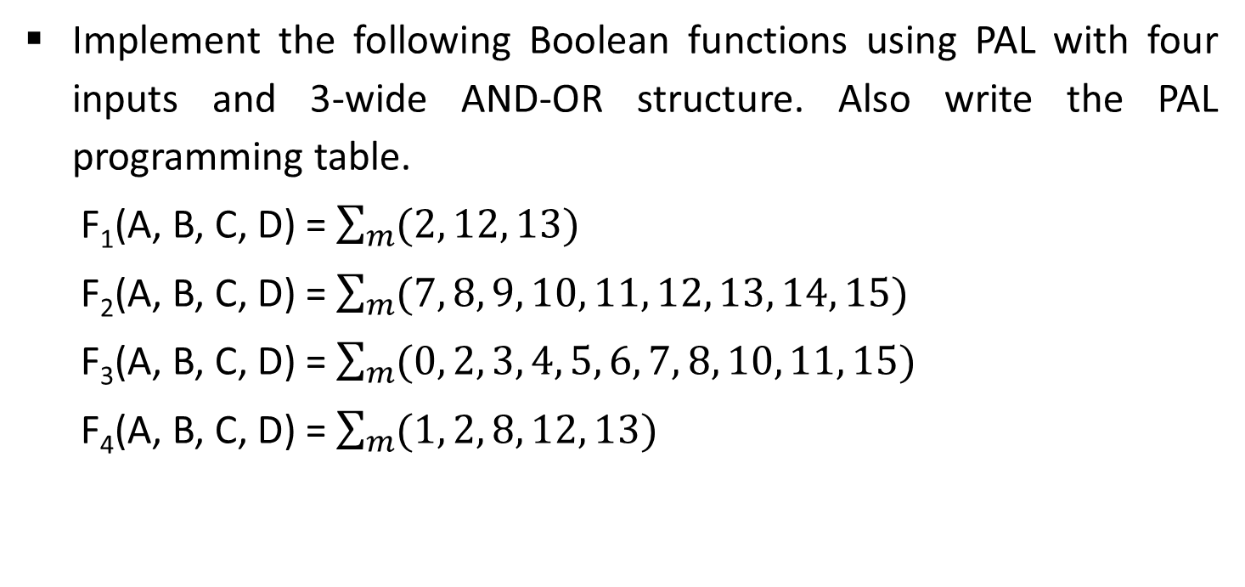
PAL Example
Implement the following Boolean functions using PAL with four inputs and 3-wide AND-OR structure. Also write the PAL programming table.
F₁(A, B, C, D) = $\sum_{m}{(2, 12, 13)}$
F₂(A, B, C, D) = $\sum_{m}{(7, 8, 9, 10, 11, 12, 13, 14, 15)}$
F₃(A, B, C, D) = $\sum_{m}{(0, 2, 3, 4, 5, 6, 7, 8, 10, 11, 15)}$
F₄(A, B, C, D) = $\sum_{m}{(1, 2, 8, 12, 13)}$

Slide 32
AB
AB
00
01
11
10
00
01
11
10
CD
CD
0
4
12
8
0
4
12
8
00
1
00
1
1
1
5
13
9
1
5
13
9
01
1
01
1
1
3
7
15
11
3
7
15
11
11
11
1
1
1
2
6
14
10
2
6
14
10
10
1
10
1
1
F₁ = ABC’ + A’B’CD’
F₂ = A + BCD

Slide 33
AB
AB
00
01
11
10
00
01
11
10
CD
CD
0
4
12
8
0
4
12
8
00
1
1
1
00
1
1
1
5
13
9
1
5
13
9
01
1
01
1
1
3
7
15
11
3
7
15
11
11
1
1
1
1
11
2
6
14
10
2
6
14
10
10
1
1
1
10
1
F₃ = CD + A’B + B’D’
F₄ = ABC’ + AC’D’ + A’B’C’D + A’B’CD’
= F₁ + AC’D’ + A’B’C’D

Slide 34
Product term | AND Inputs |  |  |  |  | Outputs
 | A | B | C | D | F₁
1 | 1 | 1 | 0 | - | - | F₁ = ABC’ + A’B’CD’
2 | 0 | 0 | 1 | 0 | -
3 | - | - | - | - | -
4 | 1 | - | - | - | - | F₂ = A + BCD
5 | - | 1 | 1 | 1 | -
6 | - | - | - | - | -
7 | 0 | 1 | - | - | - | F₃ = CD + A’B + B’D’
8 | - | - | 1 | 1 | -
9 | - | 0 | - | 0 | -
10 | - | - | - | - | 1 | F₄ = F₁ + AC’D’ + A’B’C’D
11 | 1 | - | 0 | 0 | -
12 | 0 | 0 | 0 | 1 | -

Slide 35
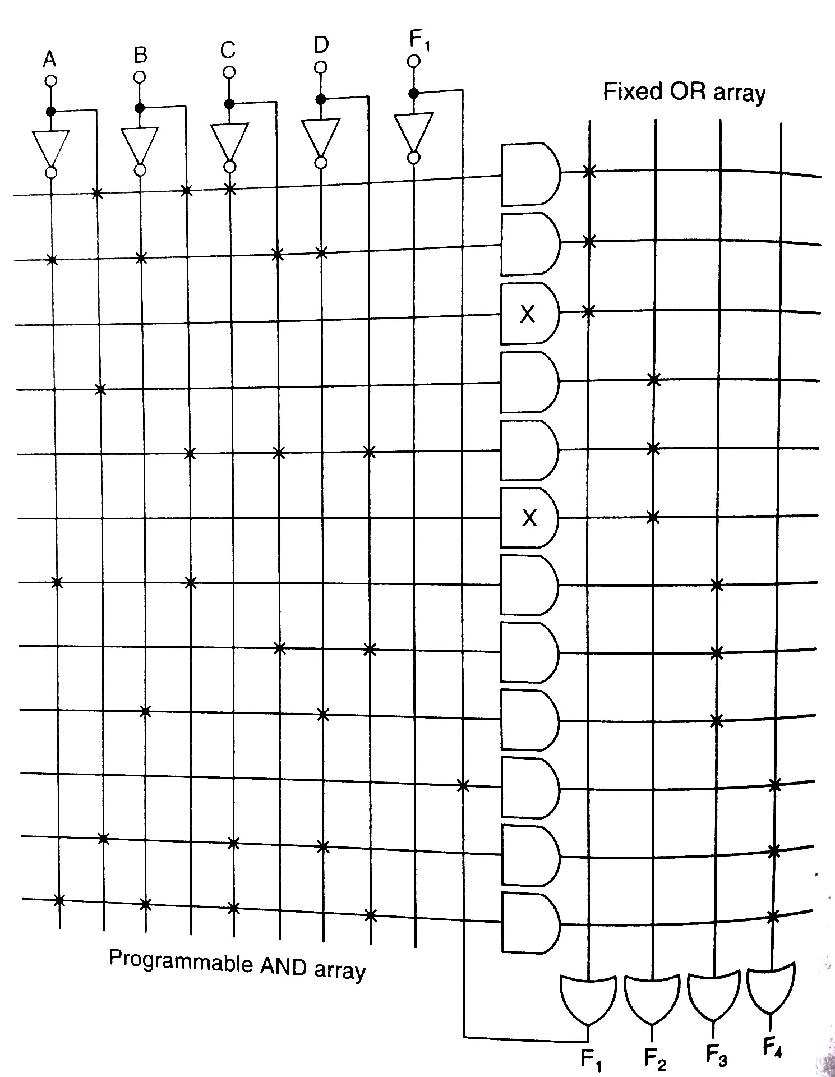

Slide 36
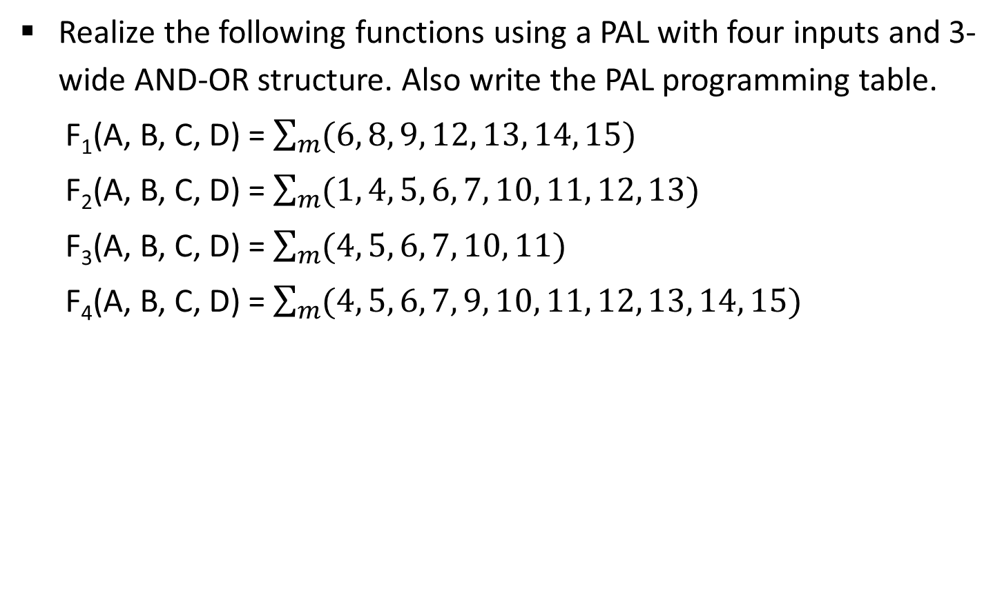
Exercise
Realize the following functions using a PAL with four inputs and 3-wide AND-OR structure. Also write the PAL programming table.
F₁(A, B, C, D) = $\sum_{m}{(6, 8, 9, 12, 13, 14, 15)}$
F₂(A, B, C, D) = $\sum_{m}{(1, 4, 5, 6, 7, 10, 11, 12, 13)}$
F₃(A, B, C, D) = $\sum_{m}{(4, 5, 6, 7, 10, 11)}$
F₄(A, B, C, D) = $\sum_{m}{(4, 5, 6, 7, 9, 10, 11, 12, 13, 14, 15)}$

Slide 37
Programmable Logic Array
The PLA combines the characteristics of the PROM and the PAL by providing both a programmable OR array and a programmable AND array, i.e. in a PLA both AND gates and OR gates have fuses at the inputs.
A third set of fuses in the output inverters allows the output function to be inverted if required.

Slide 38
3-input 4-output PLA
C
B
A
Programmable AND gates
Programmable OR gates
Out-1
Out-2
Out-3
Out-4

Slide 39
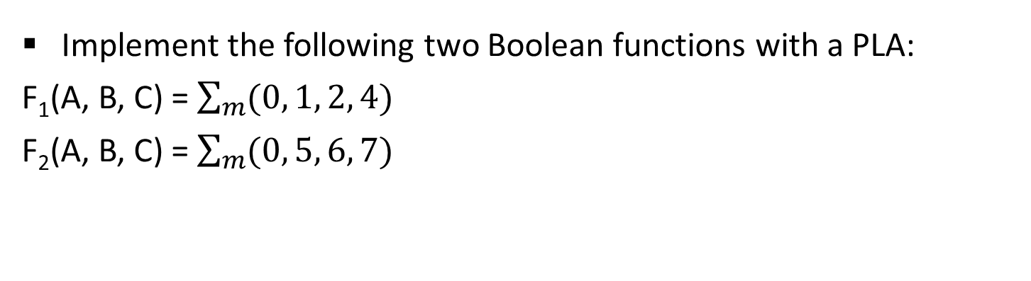
PLA Example
Implement the following two Boolean functions with a PLA:
F₁(A, B, C) = $\sum_{m}{(0, 1, 2, 4)}$
F₂(A, B, C) = $\sum_{m}{(0, 5, 6, 7)}$
AB
AB
00
01
11
10
00
01
11
10
C
C
0
2
6
4
0
2
6
4
0
1
1
1
0
0
1
3
7
5
1
3
7
5
1
1
1
0
0
0
F₁ (T) = A’C’ + B’C’ + A’B’
F₁ = (A’+B’) (B’+C’) (A’+C’)
F₁’ = AB + AC + BC
F₁(C) = (AB + AC + BC)’

Slide 40
AB
AB
00
01
11
10
00
01
11
10
C
C
0
2
6
4
0
2
6
4
0
1
1
0
0
0
1
3
7
5
1
3
7
5
1
1
1
1
0
0
F₂ (T) = A’B’C’ + AB + AC
F₂ = (A+B’) (A+C’) (A’+B+C)
F₂’ = A’B + A’C + AB’C’
F₂(C) = (A’B + A’C + AB’C’)’
Product term |  | Inputs |  |  | Outputs
 |  | A | B | C | F₁(C) | F₂(T)
1 | AB | 1 | 1 | - | 1 | 1
2 | AC | 1 | - | 1 | 1 | 1
3 | BC | - | 1 | 1 | 1 | -
4 | A’B’C’ | 0 | 0 | 0 | - | 1

Slide 41
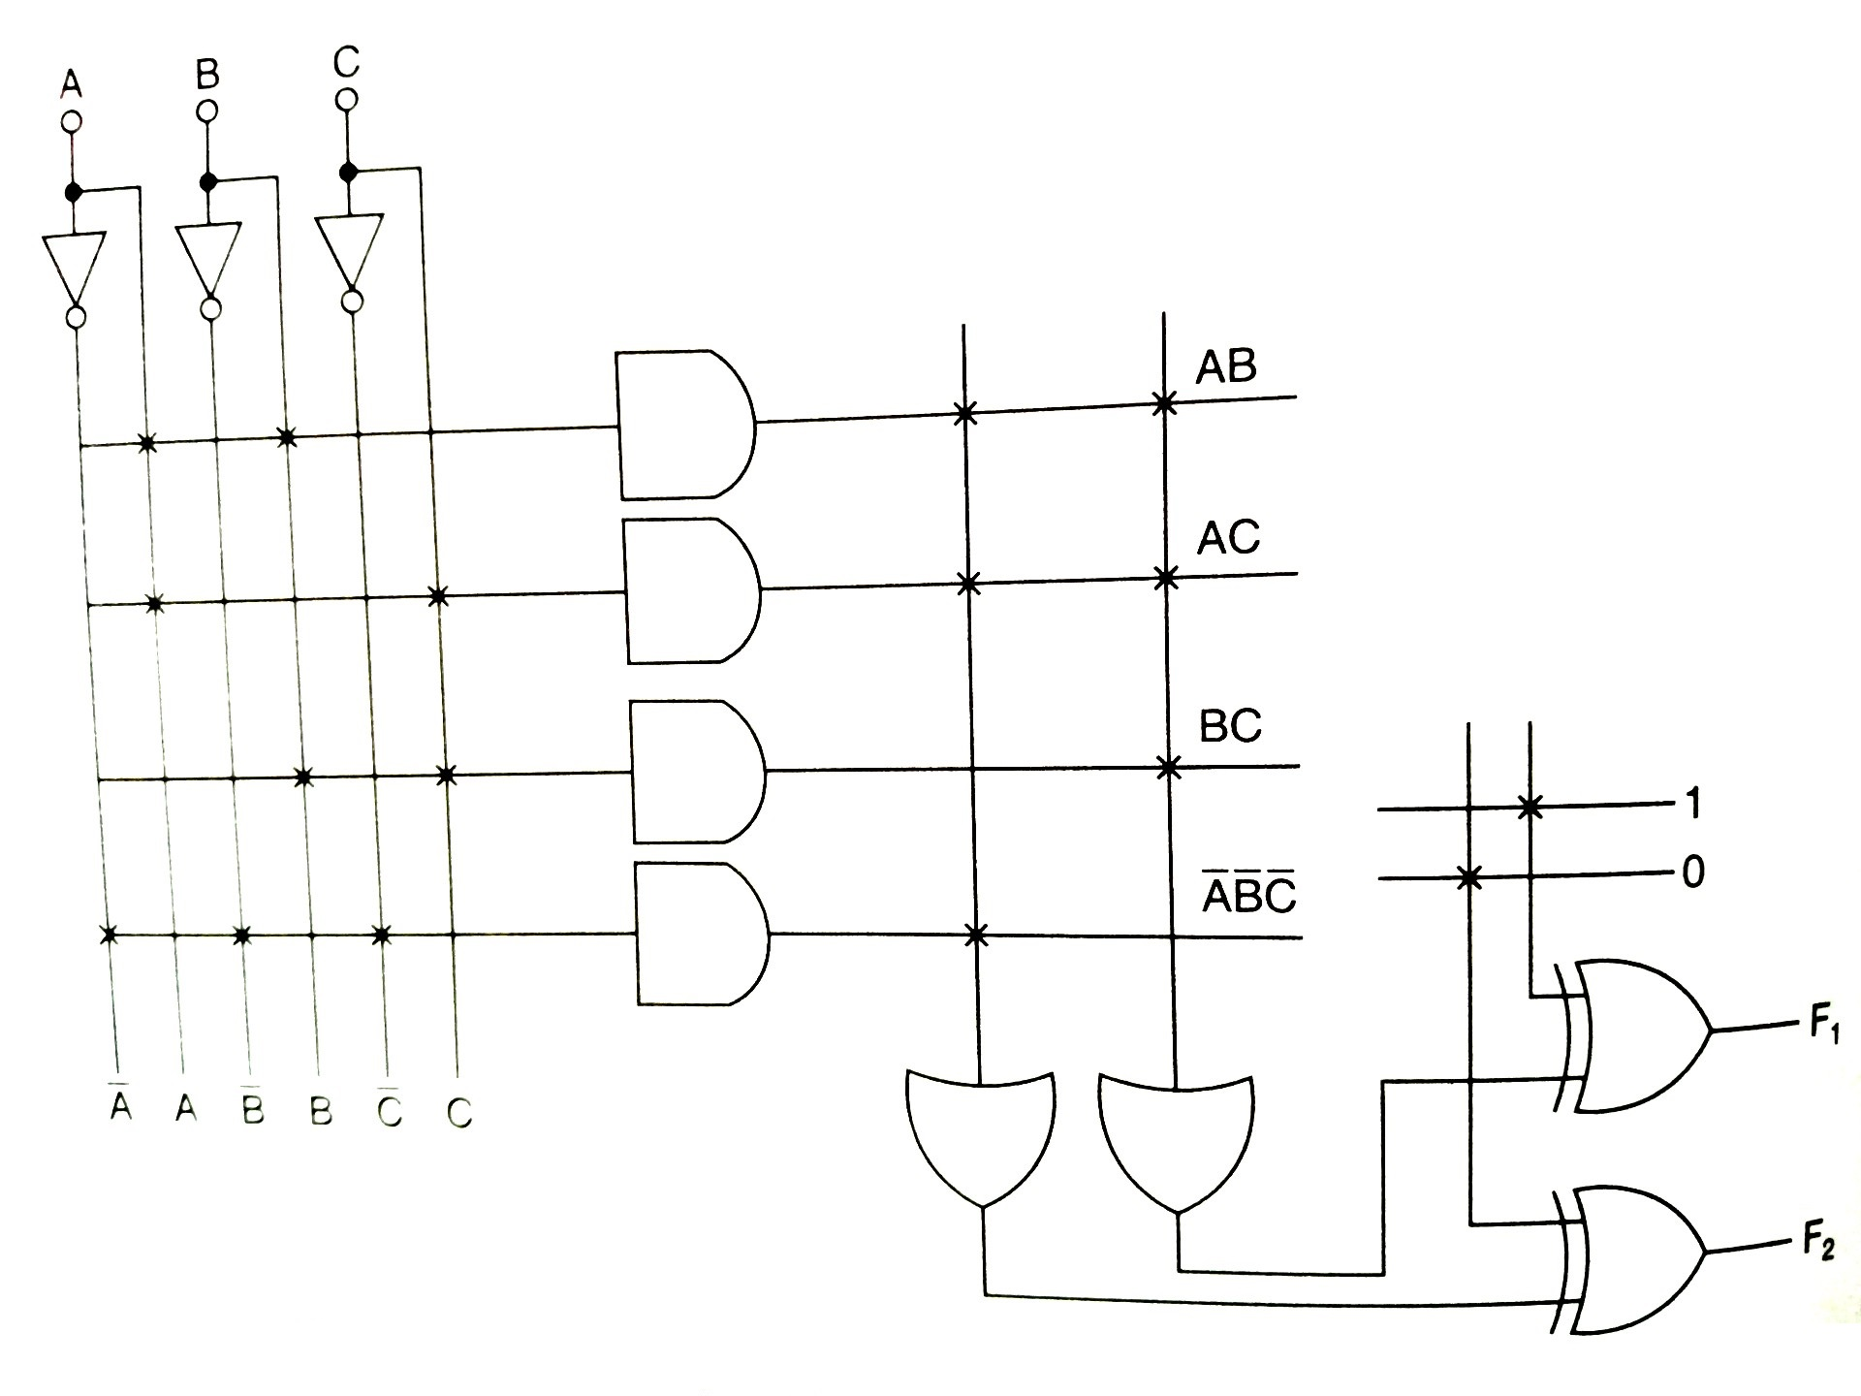

Slide 42
Exercise
Implement following Boolean functions using PLA.
F₁ = A’B + AC’ + A’BC’
F₂ = (AC’ + B’C)’

Slide 43
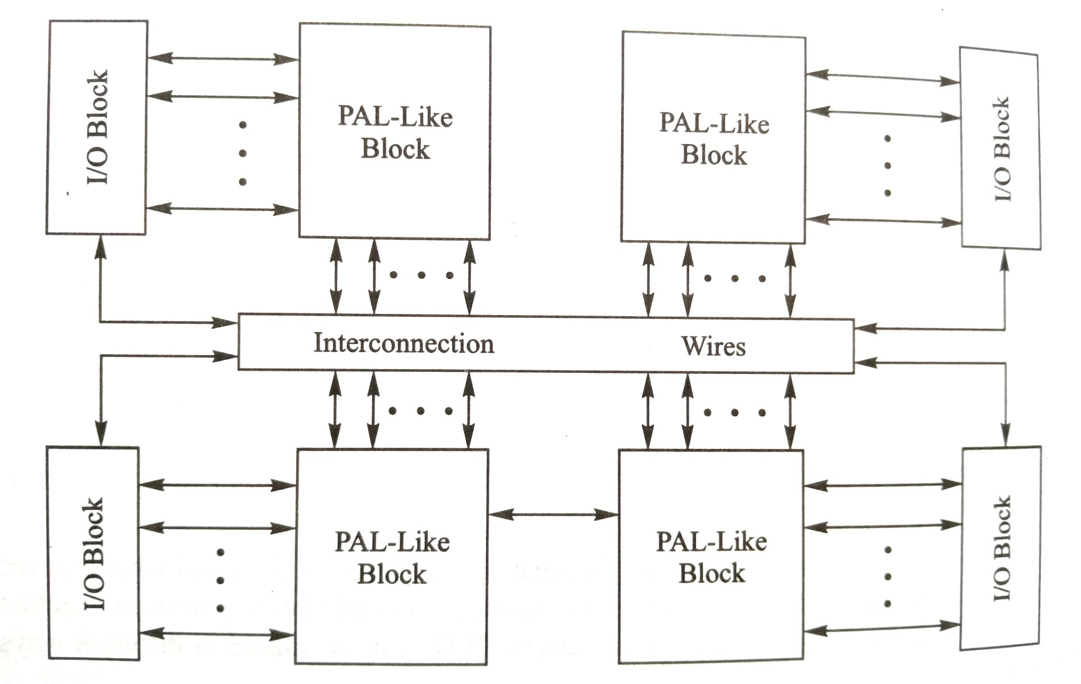
Complex programmable logic devices (CPLD)

Slide 44
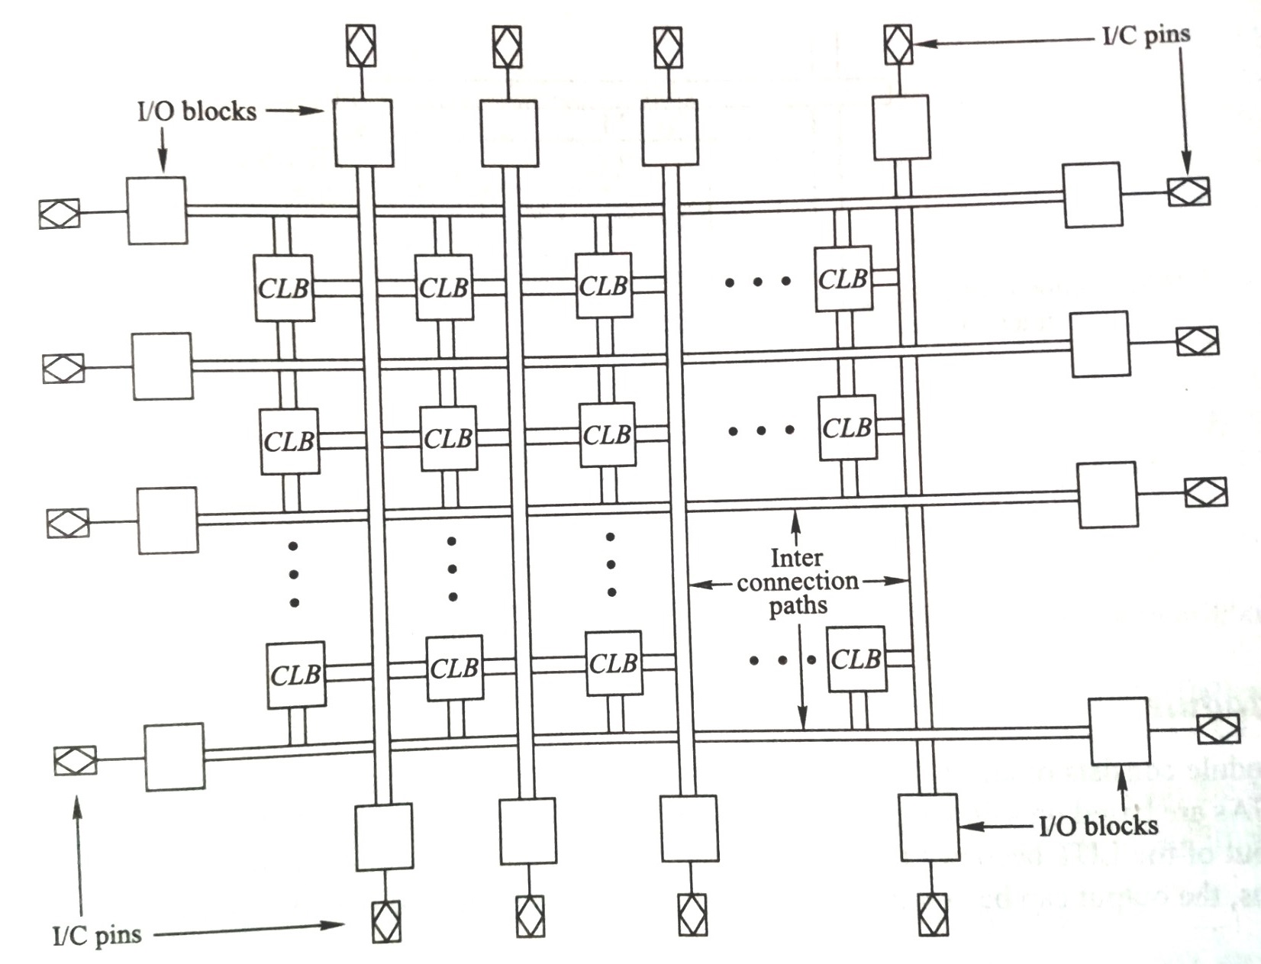
Field programmable gate array (FPGA)

